Slide 1
CHAPTER 2 Charting a Company’s Direction: Its Vision, Mission, Objectives, and Strategy

Slide 2
LEARNING OBJECTIVES
THIS CHAPTER WILL HELP YOU UNDERSTAND:
Why it is critical for company managers to have a clear strategic vision of where a company needs to head and why
The importance of setting both strategic and financial objectives
Why the strategic initiatives taken at various organizational levels must be tightly coordinated to achieve companywide performance targets
What a company must do to achieve operating excellence and to execute its strategy proficiently
The role and responsibility of a company’s board of directors in overseeing the strategic management process

Slide 3
WHAT DOES THE STRATEGY-MAKING, STRATEGY-EXECUTING PROCESS ENTAIL?
Developing a strategic vision, a mission statement, and a set of core values
Setting objectives for measuring the firm's performance and tracking its progress
Crafting a strategy to move the firm along its strategic course and achieve its objectives
Executing the chosen strategy efficiently and effectively
Monitoring developments, evaluating performance, and initiating corrective adjustments

Slide 4
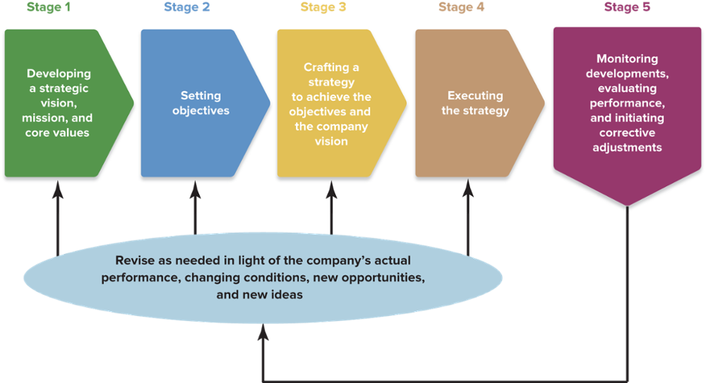
FIGURE 2.1 The Strategy-Making, Strategy-Executing Process
Jump to Appendix 1 long image description

Slide 5
STRATEGIC MANAGEMENT PRINCIPLE (1 of 7)
A company’s strategic plan lays out its future direction, performance targets, and strategy.

Slide 6
STAGE 1: DEVELOPING A STRATEGIC VISION, A MISSION STATEMENT, AND A SET OF CORE VALUES
Developing a strategic vision
Delineates management’s aspirations for the firm to its stakeholders
Provides direction: “where we are going”
Sets out the compelling rationale (strategic soundness) for the firm’s direction
Uses distinctive and specific language to set the firm apart from its rivals

Slide 7
CORE CONCEPT (1 of 8)
A strategic vision describes management’s aspirations for the company’s future and the course and direction charted to achieve them.

Slide 8
TABLE 2.1 Wording a Vision Statement—the Dos and Don’ts (1 of 2)
The Dos | The Don’ts
Be graphic. Paint a clear picture of where the company is headed and the market position(s) the company is striving to stake out. | Don’t be vague or incomplete. Never skimp on specifics about where the company is headed or how the company intends to prepare for the future.
Be forward-looking and directional. Describe the strategic course that will help the company prepare for the future. | Don’t dwell on the present. A vision is not about what a company once did or does now; it’s about “where we are going.”
Keep it focused. Focus on providing managers with guidance in making decisions and allocating resources. | Don’t use overly broad language. All-inclusive language that gives the company license to pursue any opportunity must be avoided.
Have some wiggle room. Language that allows some flexibility allows the directional course to be adjusted as market, customer, technology circumstances change. | Don’t state the vision in bland or uninspiring terms. The best vision statements have the power to motivate company personnel and inspire shareholder confidence about the company’s future.

Slide 9
TABLE 2.1 Wording a Vision Statement—the Dos and Don’ts (2 of 2)
The Dos | The Don’ts
Be sure the journey is feasible. The path and direction should be within the realm of what the company can accomplish; over time, a company should be able to demonstrate measurable progress in achieving the vision. | Don’t be generic. A vision statement that could apply to companies in any of several industries (or to any of several companies in the same industry) is not specific enough to provide any guidance.
Indicate why the directional path makes good business sense. The directional path should be in the long-term interests of stakeholders, especially shareowners, employees, and suppliers. | Don’t rely on superlatives. Visions that claim the company’s strategic course is one of being the “best” or “most successful” usually lack specifics about the path the company is taking to get there.
Make it memorable. To give the organization a sense of direction and purpose, the vision needs to be easily communicated. Ideally, it should be reducible to a few choice lines or a memorable “slogan.” | Don’t run on and on. A vision statement that is not short and to the point will tend to lose its audience.

Slide 10
Examples of Strategic Visions—How Well Do They Measure Up? (1 of 2)
Vision Statement | Effective Elements | Shortcomings
Whole Foods Whole Foods Market is a dynamic leader in the quality food business. We are a mission-driven company that aims to set the standards of excellence for food retailers. We are building a business in which high standards permeate all aspects of our company. Quality is a state of mind at Whole Foods Market. Our motto—Whole Foods, Whole People, Whole Planet—emphasizes that our vision reaches far beyond just being a food retailer. Our success in fulfilling our vision is measured by customer satisfaction, team member happiness and excellence, return on capital investment, improvement in the state of the environment and local and larger community support. Our ability to instill a clear sense of interdependence among our various stakeholders (the people who are interested and benefit from the success of our company) is contingent upon our efforts to communicate more often, more openly, and more compassionately. Better communication equals better understanding and more trust. | Forward- looking Graphic Focused Makes good business sense | Too long Not memorable

Slide 11
Examples of Strategic Visions—How Well Do They Measure Up? (2 of 2)
Vision Statement | Effective Elements | Shortcomings
Keurig Become the world’s leading personal beverage systems company. | Focused Flexible Makes good business sense | Not graphic Lacks specifics Not forward-looking
Nike NIKE, Inc. fosters a culture of invention. We create products, services and experiences for today’s athlete* while solving problems for the next generation. *If you have a body, you are an athlete. | Forward-looking Flexible | Vague and lacks detail Not focused Generic Not necessarily feasible

Slide 12
Strategic Vision Examples—How Well Do They Measure Up?
For which of these businesses is it the most difficult to create a vision statement?
How does the scope of a business affect the language of its vision statement?
How would you reword the Whole Foods mission statement to reduce it to less than 100 words? (Currently = 154 words)

Slide 13
COMMUNICATING THE STRATEGIC VISION
Why communicate the vision?
Fosters employee commitment to the firm’s chosen strategic direction
Ensures understanding of its importance
Motivates, informs, and inspires internal and external stakeholders
Demonstrates top management support for the firm’s future strategic direction and competitive efforts

Slide 14
STRATEGIC MANAGEMENT PRINCIPLE (2 of 7)
An effectively communicated vision is a valuable management tool for enlisting the commitment of company personnel to engage in actions that move the company forward in the intended direction.

Slide 15
PUTTING THE STRATEGIC VISION IN PLACE
Put the vision in writing and distribute it.
Hold meetings to personally explain the vision and its rationale.
Create a memorable slogan or phrase that effectively expresses the essence of the vision.
Emphasize the positive payoffs for making the vision happen.

Slide 16
WHY A SOUND, WELL-COMMUNICATED STRATEGIC VISION MATTERS
It crystallizes senior executives’ own views about the firm’s long-term direction.
It reduces the risk of rudderless decision making.
It is a tool for winning the support of organization members to help make the vision a reality.
It provides a beacon for lower-level managers in setting departmental objectives and crafting departmental strategies that are in sync with the firm’s overall strategy.
It helps an organization prepare for the future.

Slide 17
DEVELOPING A COMPANY MISSION STATEMENT
The mission statement:
Uses specific language to give the firm its own unique identity
Describes the firm’s current business and purpose—“who we are, what we do, and why we are here”
Should focus on describing the firm’s business, not on “making a profit”—earning a profit is an objective not a mission

Slide 18
STRATEGIC MANAGEMENT PRINCIPLE (3 of 7)
The distinction between a strategic vision and a mission statement is fairly clear-cut.
A strategic vision portrays a firm’s aspirations for its future (“where we are going”).
A firm’s mission describes the scope and purpose of its present business (“who we are, what we do, and why we are here”).

Slide 19
THE IDEAL MISSION STATEMENT
Identifies the firm’s product or services
Specifies the buyer needs it seeks to satisfy
Identifies the customer groups or markets it is endeavoring to serve
Specifies its approach to pleasing customers
Sets the firm apart from its rivals
Clarifies the firm’s business to stakeholders

Slide 20
LINKING THE VISION AND MISSION WITH CORE VALUES
Core values
Are the beliefs, traits, and behavioral norms that employees are expected to display in conducting the firm’s business and in pursuing its strategic vision and mission
Become an integral part of the firm’s culture and what makes it tick when strongly espoused and supported by top management
Match the firm’s vision, mission, and strategy, contributing to the firm’s business success

Slide 21
CORE CONCEPT (2 of 8)
A firm’s core values are the beliefs, traits, and behavioral norms that the firm’s personnel are expected to display in conducting the firm’s business and pursuing its strategic vision and mission.

Slide 22
Patagonia, Inc.: A Values-Driven Company (1 of 2)
Patagonia’s mission statement
Build the best product, cause no unnecessary harm, use business to inspire and implement solutions to the environmental crisis
Patagonia’s core values
Quality: Pursuit of ever-greater quality in everything we do
Integrity: Relationships built on integrity and respect
Environmentalism: Serve as a catalyst for personal and corporate action
Not Bound by Convention: Our success—and much of the fun—lies in developing innovative ways to do things

Slide 23
Patagonia, Inc.: A Values-Driven Company (2 of 2)
Examining Patagonia’s core values
How do Patagonia’s core values reflect the value it places on its human capital?
What effects do Patagonia’s core values have on its hiring practices?
How does Patagonia’s relentless attention to the management of its supply chain support its core values?
Why has Patagonia been successful in holding its contract manufacturers accountable when other firms have not?

Slide 24
STAGE 2: SETTING OBJECTIVES
The purposes of setting objectives
To convert the vision and mission into specific, measurable, challenging and timely performance targets
To focus efforts and align actions throughout the organization
To serve as yardsticks for tracking a firm’s performance and progress
To provide motivation and inspire employees to greater levels of effort

Slide 25


CONVERTING THE VISION AND MISSION INTO SPECIFIC PERFORMANCE TARGETS
Specific
Characteristics of Well-Stated Objectives
Quantifiable (Measurable)
Challenging (Motivating)
Deadline for Achievement
Jump to Appendix 2 long image description

Slide 26
CORE CONCEPTS (3 of 8)
Objectives are an organization’s performance targets—the specific results management wants to achieve.
Stretch objectives set performance targets high enough to stretch an organization to reach its full potential and deliver the best possible results.

Slide 27
CORE CONCEPT (4 of 8)
A company exhibits strategic intent when it relentlessly pursues an ambitious strategic objective, concentrating the full force of its resources and competitive actions on achieving that objective.

Slide 28
CHARACTERISTICS OF STRATEGIC INTENT
Indicates firm’s intent to making quantum gains in competing against key rivals and to establishing itself as a winner in the marketplace, often against long odds.
Involves establishing a grandiose performance target out of proportion to immediate capabilities and market position, but then devoting the firm’s full resources and energies to achieving the target over time.
Entails sustained, aggressive actions to take market share away from rivals and achieve a much stronger market position.

Slide 29
THE IMPERATIVE OF SETTING STRETCH OBJECTIVES
Setting stretch objectives promotes better overall performance because stretch targets:
Push a firm to be more inventive.
Increase the urgency for improving financial performance and competitive position.
Cause the firm to be more intentional and focused in its actions.
Act to prevent internal inertia and contentment with modest to average gains in performance.

Slide 30
THE NEED FOR SHORT-TERM AND LONG-TERM OBJECTIVES
Short-Term Objectives:
Focus attention on quarterly and annual performance improvements to satisfy near-term shareholder expectations.
Long-Term Objectives:
Force consideration of what to do now to achieve optimal long-term performance.
Stand as a barrier to an undue focus on short-term results.

Slide 31
CORE CONCEPTS (5 of 8)
Financial objectives relate to the financial performance targets management has established for the organization to achieve.
Strategic objectives relate to target outcomes that indicate a company is strengthening its market standing, competitive position, and future business prospects.

Slide 32
WHAT KINDS OF OBJECTIVES TO SET
Financial Objectives
Communicate top management’s goals for financial performance.
Are focused internally on the firm’s operations and activities.
Strategic Objectives
Are the firm's goals related to marketing standing and competitive position.
Are focused externally on competition vis-à-vis the firm’s rivals.

Slide 33
SETTING FINANCIAL OBJECTIVES
An x percent increase in annual revenues
Annual increases in after-tax profits of x percent
Annual increases in earnings per share of x percent
Annual dividend increases of x percent
Profit margins of x percent
An x percent return on capital employed (ROCE) or return on shareholders’ equity investment (ROE)
Increased shareholder value—in the form of an upward-trending stock price
Bond and credit ratings of x
Internal cash flows of x dollars to fund new capital investment

Slide 34
SETTING STRATEGIC OBJECTIVES
Winning an x percent market share
Achieving lower overall costs than rivals
Overtaking key competitors on product performance or quality or customer service
Deriving x percent of revenues from the sale of new products introduced within the past five years
Having broader or deeper technological capabilities than rivals
Having a wider product line than rivals
Having a better-known or more powerful brand name than rivals
Having stronger national or global sales and distribution capabilities than rivals
Consistently getting new or improved products to market ahead of rivals

Slide 35
CORE CONCEPT (6 of 8)
The Balanced Scorecard is a widely used method for combining the use of both strategic and financial objectives, tracking their achievement, and giving management a more complete and balanced view of how well an organization is performing.

Slide 36
THE NEED FOR A BALANCED APPROACH TO OBJECTIVE SETTING
A balanced scorecard measures a firm’s optimal performance by:
Placing a balanced emphasis on achieving both financial and strategic objectives.
Tracking both measures of financial performance and measures of whether a firm is strengthening its competitiveness and market position.

Slide 37
GOOD STRATEGIC PERFORMANCE IS THE KEY TO BETTER FINANCIAL PERFORMANCE
Good financial performance is not enough:
Current financial results are lagging indicators of past decisions and actions which does not translate into a stronger competitive capability for delivering better financial results in the future.
Setting and achieving stretch strategic objectives signals a firm’s growth in both competitiveness and strength in the marketplace.
Good strategic performance is a leading indicator of a firm’s increasing capability to deliver improved future financial performance.

Slide 38
SETTING OBJECTIVES FOR EVERY ORGANIZATIONAL LEVEL
Breaks down performance targets for each of the organization’s separate units.
Fosters setting performance targets that support achievement of firm-wide strategic and financial objectives.
Extends the top-down objective-setting process to all organizational levels.

Slide 39
EXAMPLES OF COMPANY OBJECTIVES
United Parcel Service, Alcoa, Yum! Brands
Which company included the most specific strategic objectives in its listing of objectives?
Which company has the shortest-term focus based on its objectives? Which has the longest-term focus?
Which company’s listing of objectives appears to best fit the balanced scorecard concept?

Slide 40
STAGE 3: CRAFTING A STRATEGY
Strategy making:
Addresses a series of strategic how’s.
Requires choosing among strategic alternatives.
Promotes actions to do things differently from competitors rather than running with the herd.
Is a collaborative team effort that involves managers in various positions at all organizational levels.

Slide 41
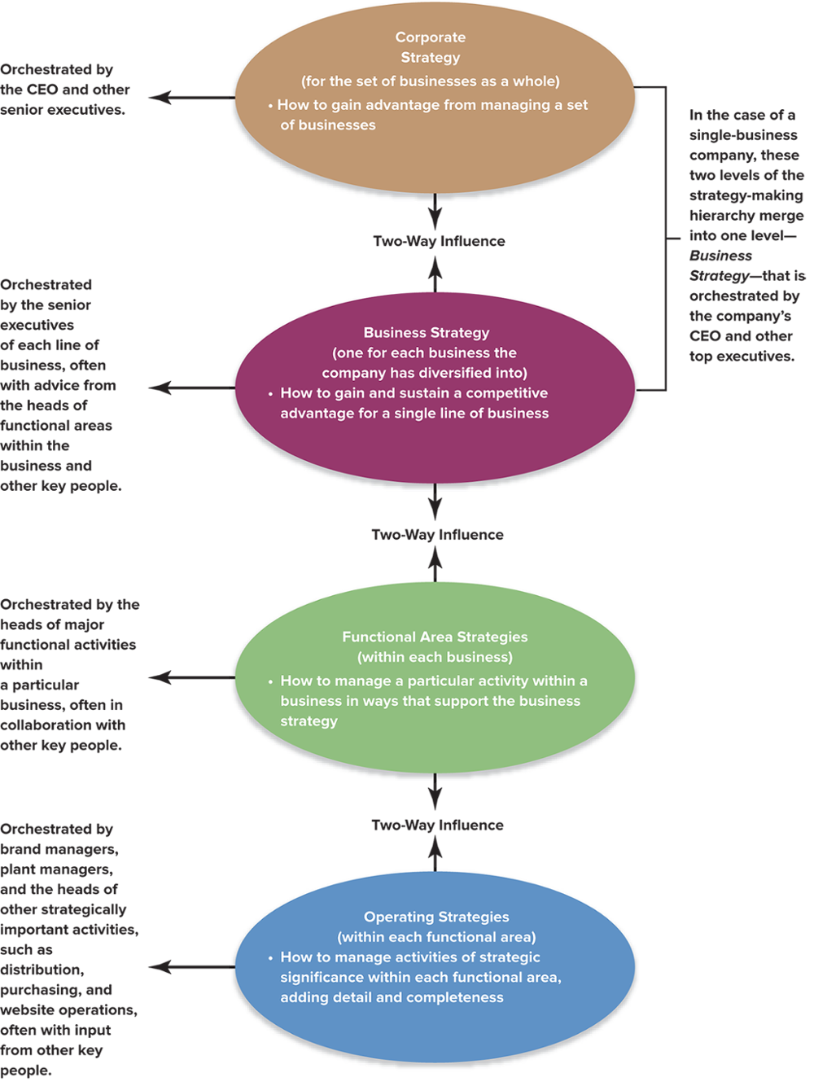
FIGURE 2.2 A Company’s Strategy-Making Hierarchy
Jump to Appendix 3 long image description

Slide 42
STRATEGY MAKING INVOLVES MANAGERS AT ALL ORGANIZATIONAL LEVELS
Chief executive officer (CEO)
Has ultimate responsibility for leading the strategy-making process as strategic visionary and chief architect of strategy
Senior executives
Fashion the major strategy components involving their areas of responsibility
Managers of subsidiaries, divisions, geographic regions, plants, and other operating units (and key employees with specialized expertise)
Utilize on-the-scene familiarity with their business units to orchestrate their specific pieces of the strategy

Slide 43
STRATEGIC MANAGEMENT PRINCIPLE (4 of 7)
In most firms, crafting and executing strategy is a collaborative team effort in which every manager has a role for the area he or she heads; it is rarely something that only high-level managers do.

Slide 44
WHY IS STRATEGY-MAKING OFTEN A COLLABORATIVE PROCESS?
The many complex strategic issues involved and multiple areas of expertise required can make the strategy-making task too large for one person or a small executive group.
When operations involve different products, industries and geographic areas, strategy-making authority must be delegated to functional and operating unit managers such that all managers have a strategy-making role—ranging from major to minor—for the area they head!

Slide 45
A FIRM’S STRATEGY-MAKING HIERARCHY (1 of 2)
Corporate strategy
Multi-business strategy—how to gain synergies from managing a portfolio of businesses together rather than as separate businesses
Business strategy
How to strengthen market position and gain competitive advantage
Actions to build competitive capabilities of single businesses
Monitoring and aligning lower-level strategies

Slide 46
A FIRM’S STRATEGY-MAKING HIERARCHY (2 of 2)
Functional area strategies
Add relevant detail to the “hows” of business strategy
Provide a game plan for managing a particular activity in ways that support the business strategy
Operational strategies
Add detail and completeness to business and functional strategies
Provide a game plan for managing specific operating activities with strategic significance
NOTE: These four strategies all impact each other.

Slide 47
CORE CONCEPTS (7 of 8)
Corporate strategy is strategy at the multi-business level, concerning how to improve company performance or gain competitive advantage by managing a set of businesses simultaneously.
Business strategy is strategy at the single-business level, concerning how to improve the performance or gain a competitive advantage in a particular line of business.

Slide 48
UNITING THE STRATEGY-MAKING HIERARCHY
Corporate-level
Business-level
Functional-level
Operational-level
Jump to Appendix 4 long image description

Slide 49
STRATEGIC MANAGEMENT PRINCIPLE (5 of 7)
A firm's strategy is at full power only when many pieces of the strategy are united.
Anything less than a unified collection of strategies weakens the overall strategy and is likely to impair company performance.

Slide 50
A STRATEGIC VISION + MISSION + OBJECTIVES + STRATEGY = A STRATEGIC PLAN
Elements of a Firm’s Strategic Plan
Its strategic vision, business mission, and core values
Its strategic and financial objectives
Its chosen strategy
Jump to Appendix 5 long image description
Notes:
50

Slide 51
CORE CONCEPT (8 of 8)
A company’s strategic plan lays out its future direction, business model, performance targets, and competitive strategy.

Slide 52
STAGE 4: EXECUTING THE STRATEGY
Converting strategic plans into actions requires:
Directing organizational action
Motivating people
Building and strengthening the firm’s competencies and competitive capabilities
Creating and nurturing a strategy-supportive work climate
Meeting or beating performance targets

Slide 53
MANAGING THE STRATEGY EXECUTION PROCESS (1 of 2)
Creating a strategy-supporting structure
Staffing the firm with the needed skills and expertise
Developing and strengthening strategy-supporting resources and capabilities
Allocating ample resources to the activities critical to strategic success
Ensuring that policies and procedures facilitate effective strategy execution
Organizing work effort to achieve best practices

Slide 54
MANAGING THE STRATEGY EXECUTION PROCESS (2 of 2)
Installing information and operating systems that enable company personnel to perform essential activities
Motivating people and tying rewards and incentives directly to the achievement of performance objectives
Creating a company culture conducive to successful strategy execution
Exerting the internal leadership needed to propel implementation forward

Slide 55
STAGE 5: EVALUATING PERFORMANCE AND INITIATING CORRECTIVE ADJUSTMENTS
Evaluating performance
Deciding whether the enterprise is passing the three tests of a winning strategy—good fit, competitive advantage, strong performance.
Initiating corrective adjustment
Deciding whether to continue or change the firm’s vision and mission, objectives, strategy, and strategy execution methods
Applying lessons based on organizational learning

Slide 56
STRATEGIC MANAGEMENT PRINCIPLE (6 of 7)
A company’s vision, mission, objectives, strategy, and approach to strategy execution are never final; reviewing whether and when to make revisions is an ongoing process.

Slide 57
THE ROLE OF THE BOARD OF DIRECTORS IN CORPORATE GOVERNANCE
Obligations of the board of directors:
Oversee the firm’s financial accounting and reporting practices compliance with GAAP principles
Critically appraise the firm’s direction, strategy, and business approaches
Evaluate the caliber of senior executives’ strategic leadership skills
Institute a compensation plan that rewards top executives for actions and results that serve stakeholder interests—especially shareholders.

Slide 58
ACHIEVING EFFECTIVE CORPORATE GOVERNANCE
A strong, independent board of directors:
Is well informed about the firm’s performance
Guides and judges the CEO and other executives
Can curb management actions the board believes are inappropriate or unduly risky
Can certify to shareholders that the CEO is doing what the board expects
Provides insight and advice to top management
Is intensely involved in debating the pros and cons of key strategic decisions and actions

Slide 59
STRATEGIC MANAGEMENT PRINCIPLE (7 of 7)
Effective corporate governance requires the board of directors to oversee the company’s strategic direction, evaluate its senior executives, handle executive compensation, and oversee financial reporting practices.

Slide 60
CORPORATE GOVERNANCE FAILURE AT VOLKSWAGEN
Why does the VW advisory board refuse to accept responsibility for the continuing series of management scandals that have plagued the firm for the past two decades?
How has the government-mandated two-tier governance structure promoted misconduct in the organization?
What must be changed at VW to restore stakeholder confidence in the firm?

Slide 61
Appendix 1 Figure 2.1 The Strategy-Making, Strategy-Executing Process
The five stages of the process are:
Developing a strategic vision, mission, and core values
Setting objectives
Crafting a strategy to achieve the objectives and the firm’s vision
Executing the strategy
Monitoring developments, evaluating performance, and initiating corrective adjustments
Stages 1, 2 and 3 are considered strategy making.
Stages 4 and 5 are where strategy execution occurs.
Additionally, stages 1 through 4 must be revised as needed in light of the firm's actual performance, changing conditions, new opportunities, and new ideas.
Return to slide

Slide 62
Appendix 2: Converting the Vision and Mission into Specific Performance Targets
Characteristics of well-stated objectives:
Quantifiable (measurable)
Specific (what must be done)
Challenging (motivating)
Deadline for achievement
Return to slide

Slide 63
Appendix 3: Figure 2.2 A Company’s Strategy-Making Hierarchy
Each level has influence with the level above and below it.
Corporate strategy (for the business as a whole)
Corporate strategy is orchestrated by the CEO and other senior executives.
Business strategy (one for each business the company has diversified into)
Business strategy is orchestrated by the senior executives of each line of business, often with advice from the heads of functional areas within the business and other key people.
Functional area strategies (within each business)
Functional area strategies are orchestrated by the heads of the major functional activities within a particular business, often in collaboration with other key people.
Operating strategies (within each functional area)
Operating strategies are orchestrated by brand managers, plant managers, and the heads of other strategically important activities, such as distribution, purchasing, and website operations, often with input from other key people.
In the case of a single-business company, corporate and business merge into one level.
Return to slide

Slide 64
Appendix 4: Uniting the Strategy-Making Hierarchy
A pyramid is shown with operational level at the bottom, progressing upward to functional level, business level, and at the top, corporate level.
In the center of the pyramid are two arrows, one pointing up and the other pointing down indicating the participation of managers at all levels in the organization in the strategy-making process.
Return to slide

Slide 65
Appendix 5: A Strategic Vision + Mission + Objectives + Strategy = A Strategic Plan
The elements of a firm's strategic plan are:
Its strategic vision, business mission, and core values
Its strategic and financial objectives
Its chosen strategy
Return to slide

